Slide 1
Chapter 4B
Multicollinearity

Slide 2
Outline
The nature of multicollinearity
Estimation in the presence of multicollinearity.
Practical consequences
Detection of multicollinearity
Remedial measures

Slide 3
1. The Nature of Multicollinearity
Originally it meant the existence of a “perfect,” or exact, linear relationship among some or all explanatory variables of a regression model.
Today, it includes perfect multicollinearity and less than perfect multicollinearity.
Wooldridge (2004): High (but not perfect) correlation between two or more independent variables is called multicollinearity.
Perfect multicollinearity
λ₁X₁ + λ₂X₂ + · · ·+λ_{k} X_{k} = 0
Unperfect multicollinearity
λ₁X₁ + λ₂X₂ + · · ·+λ₂X_{k} + v_{i} = 0
where v_{i} is a stochastic error term.

Slide 4
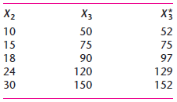
1. The Nature of Multicollinearity
A numerical example:
X_{3i} = 5X_{2i} → There is perfect collinearity between X₂ and X₃
The variable X*₃ was created from X₃ by simply adding to it the following numbers (v_{i} = 2, 0, 7, 9, 2). Now there is no longer perfect collinearity between X₂ and X*₃. However, the two variables are highly correlated because calculations will show that the coefficient of correlation between them is 0.9959.

Slide 5
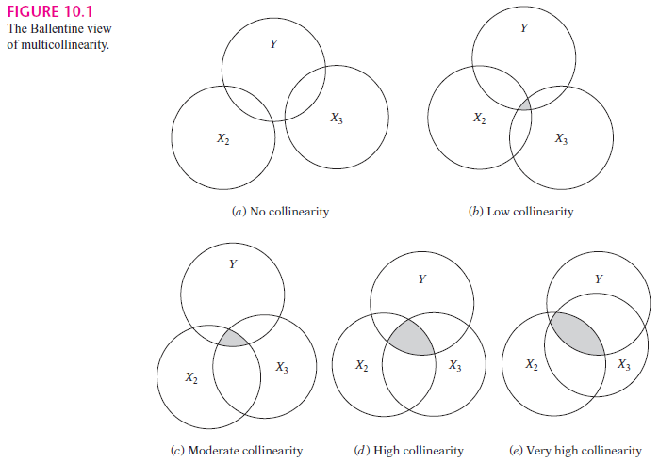
The Nature of Multicollinearity
The term

Slide 6
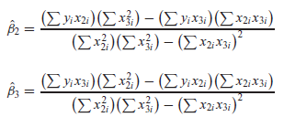


2. Estimation in the presence of multicollinearity
Perfect multicollinearity
Perfect collirearity →X_{3i} = λX_{2i} , where λ is a nonzero constant
→ the estimator is indeterminate

Slide 7
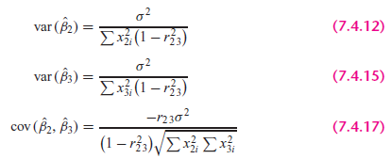
2. Estimation in the presence of multicollinearity
High multicollinearity
The variances and covariances of β₂ and β₃ are given by
→ where r₂₃ is the coefficient of correlation between X₂ and X₃.
The r₂₃ tends toward 1 as collinearity increases, the variances and covariance of the estimators increase.
Perfect collinearity: r₂₃ = 1, the variances are infinite.

Slide 8


2. Estimation in the presence of multicollinearity
The speed with which variances and covariances increase can be seen with the variance-inflating factor (VIF), which is defined as:
Using this definition, we can express

Slide 9
3. Practical consequences of Multicollinearity
High multicollinearity
1. The OLS estimators have large variances and covariances, making precise estimation difficult.
2. The confidence intervals tend to be much wider, leading to the acceptance of the “zero null hypothesis” (i.e., the true population coefficient is zero) more readily.
3. The t ratio of one or more coefficients tends to be statistically insignificant.
4. Although the t ratio of one or more coefficients is statistically insignificant, R², the overall measure of goodness of fit, can be very high.
5. The OLS estimators and their standard errors can be sensitive to small changes in the data.

Slide 10
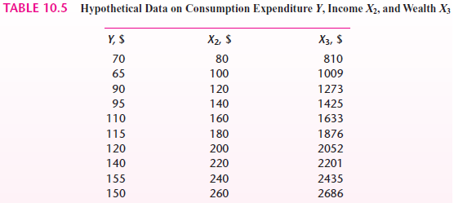

Example

Slide 11
Example
Income and wealth together explain about 96 percent of the variation in consumption expenditure .
Neither of the slope coefficients is individually statistically significant.
Not only is the wealth variable statistically insignificant but also it has the wrong sign.
H0 ( ) is rejected (F=92.40) → Consumption expenditure is related to income and wealth.
→ When collinearity is high, tests on individual regressors are not reliable.

Slide 12
Example
Correlation matrix

Slide 13
Example
Regression results

Slide 14
Example
Regression results without sibs

Slide 15
Example
Regression results without brthord

Slide 16
3. Detection of Multicollinearity
High R² but few significant t ratios. If R² is high, say, in excess of 0.8, the F test in most cases will reject the hypothesis that the partial slope coefficients are simultaneously equal to zero, but the individual t tests will show that none or very few of the partial slope coefficients are statistically different from zero.

Slide 17
3. Detection of Multicollinearity
High pair-wise correlation among regressors: a rule of thumb indicates that the pair-wise correlation is high, say, in excess of 0.8, then multicollinearity is a serious problem. → This is a sufficient but not necessary condition. The model involving more than two explanatory variables, the correlations will not provide an infallible guide to the presence of multicollinearity.
Auxiliary regressions: to regress each Xi on the remaining X variables and compute the corresponding R². If the computed F exceeds the critical F_{i} at the chosen level of significance, it is taken to mean that the particular X_{i} is collinear with other X’s;

Slide 18

3. Detection of Multicollinearity
Tolerance and variance inflation factor: if the VIF of a variable exceeds 10, which will happen if R²_{j} exceeds 0.90, that variable is said be highly collinear
The inverse of the VIF is called tolerance (TOL). That is,
When R²_{j} = 1 (i.e., perfect collinearity), TOL_{j} = 0
When R²_{j} = 0 (i.e., no collinearity whatsoever), TOL_{j} is 1

Slide 19
4. Remedial Measures
Do Nothing:
A priori information.
Combining cross-sectional and time series data.
Dropping a variable(s) and specification bias
Transformation of variables
Additional or new data.

Slide 20
Do Nothing
Multicollinearity is essentially a data deficiency problem and sometimes we have no choice over the data we have available for empirical analysis.

Slide 21
Priori information
Ex: Suppose we consider the Cobb Douglas production function of a country:
Or:
- High correlation between K and L leads to large variances of coefficient estimators.
- Based on the findings in prior literature, we know that the country has constant returns to scale: α+β = 1.

Slide 22
Priori information
Replacing β with 1-α, we obtain:
or
Where
→We estimate and compute:

Slide 23
Combining cross-sectional and time series data
Examine the demand for automobiles
Where Y= number of cars sold, P= average price, I= income, t= time.
We estimate price elasticity and income elasticity.
In time series data, the price and income variables tend to be highly collinear.

Slide 24
Combining cross-sectional and time series data
If we have cross-sectional data, for ex, data generated by consumer panes, or budget studies conducted by various private and governmental agencies → we obtain a fairly reliable estimate of the income elasticity
Time series regression:
Where:

Slide 25
Dropping a variable(s) and specification bias
When we drop the wealth variable, the income variable is now highly significant.
But we may be committing a specification bias or specification error. Economic theory says that income and wealth should both be included in the model explaining the consumption expenditure, dropping the wealth variable would constitute specification bias.
The remedy may be worse than the disease. Multicolliearity may prevent precise estimation of the parameters, whereas omitting a variable may seriously mislead us as to the true values of the parameters.

Slide 26
Transformation of variables-first difference form
Regression model:
→ It must hold at time (t-1):
→
→ The first difference regression model often reduces the severity of multicollinearity.

Slide 27
Additional or new data
Increasing the size of the sample may attenuate the collinearity problem.
The sample size increases → will increase → The variance will decrease.

